Slide 1
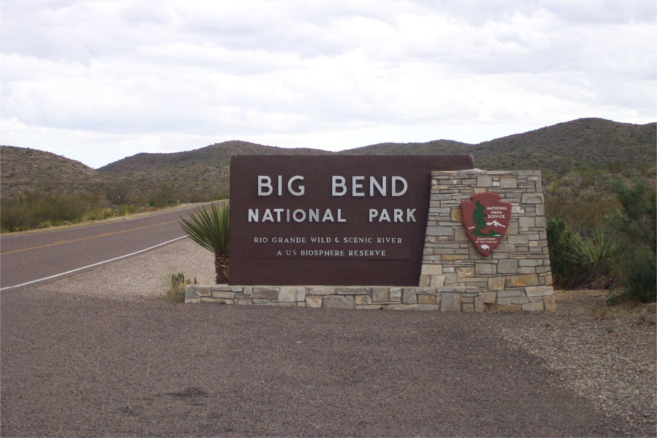
Notes:
Welcome to Big Bend National Park! OK, I’ll admit the place doesn’t look so spectacular from the entrance, but unlike Hot Springs National Park, at least Big Bend has an entrance. Actually Big Bend does have some pretty spectacular, albeit unusual, geologic features, but you’ll have to cover some ground to see them. That’s because (in stereotypical Texan style) the park is huge. So big in fact that most visitors only find time to visit the park’s central focal point …

Slide 2
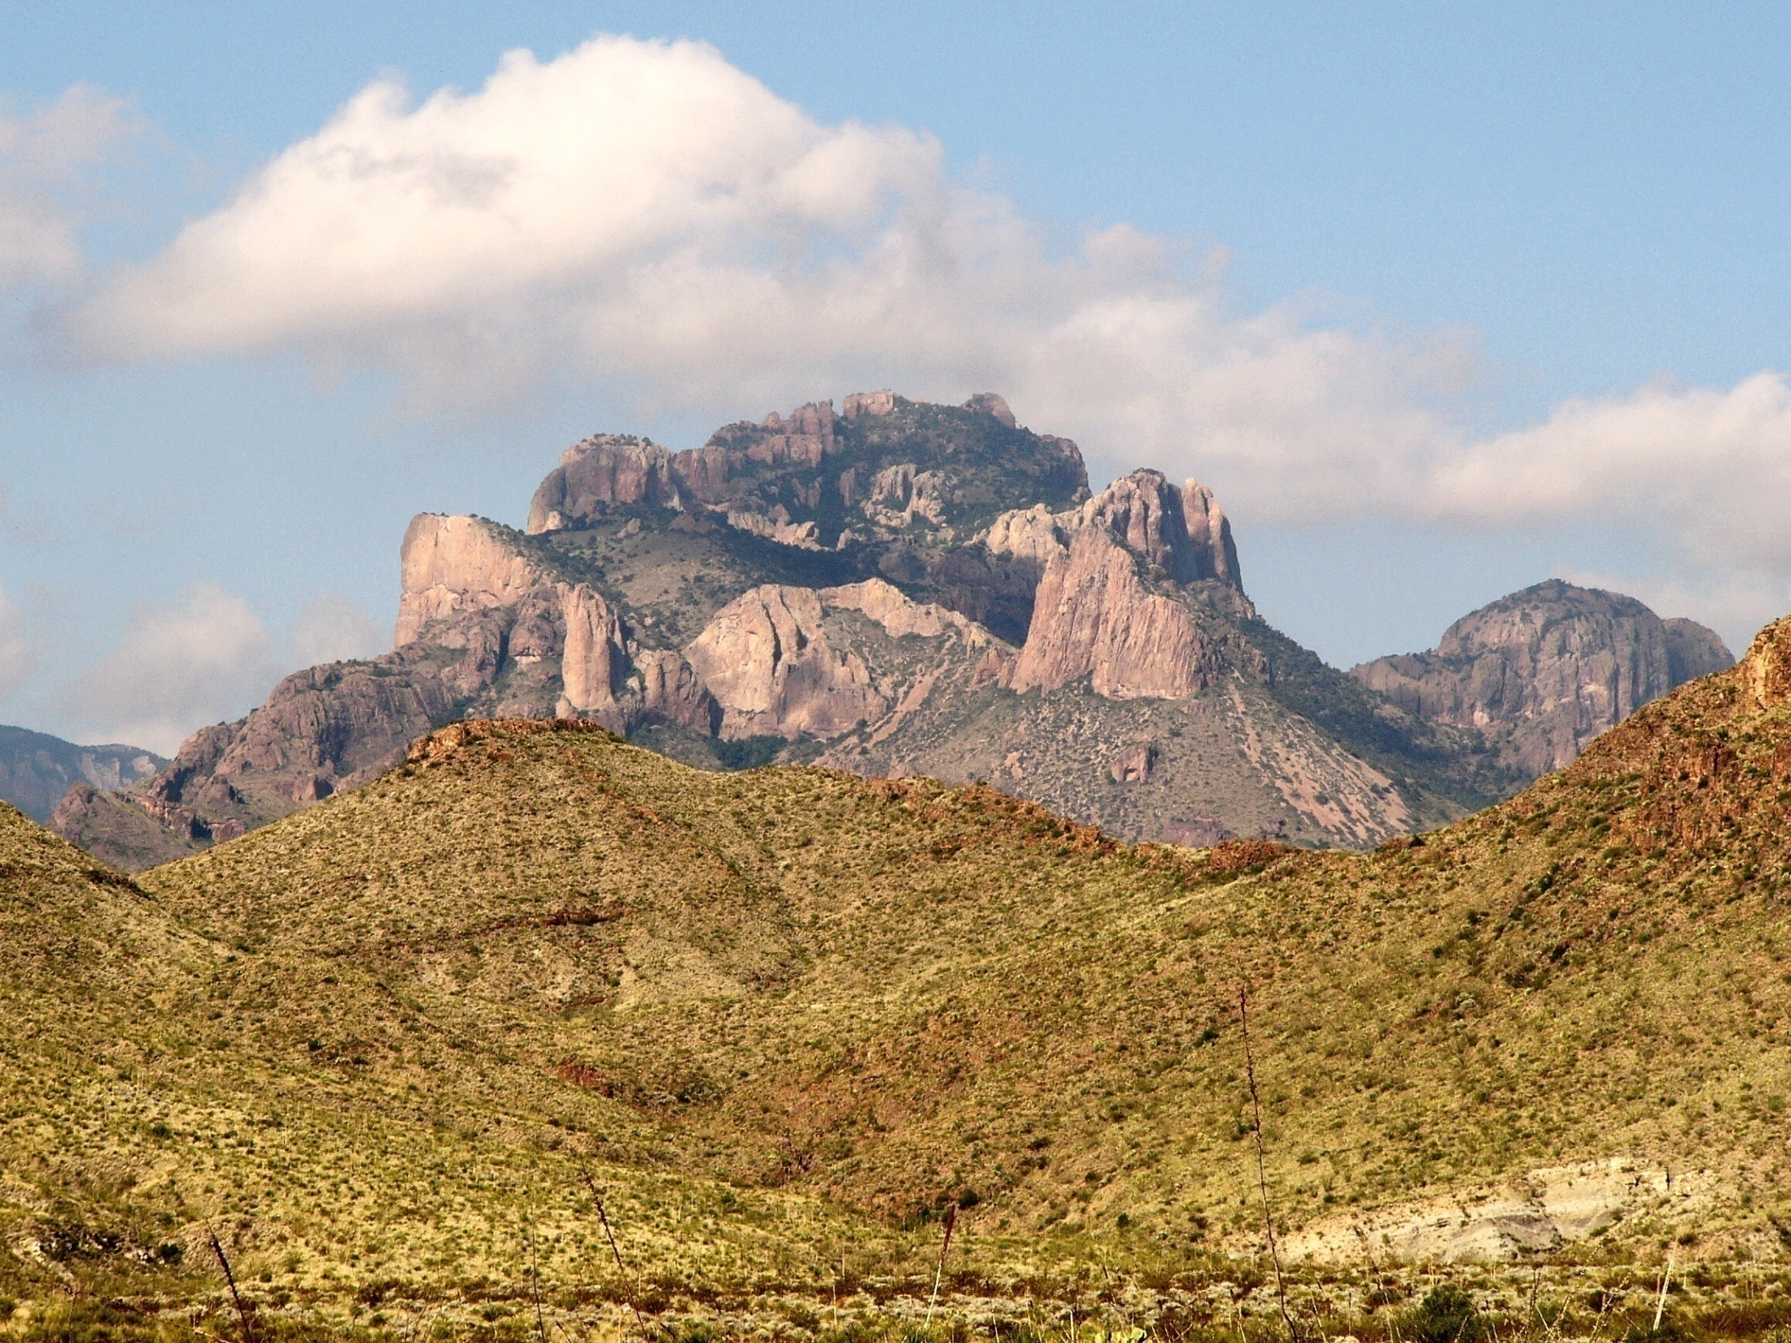
Chisos Mountains (Crown Mountain)
Notes:
… the chaotically rugged Chisos Mountains, ….

Slide 3
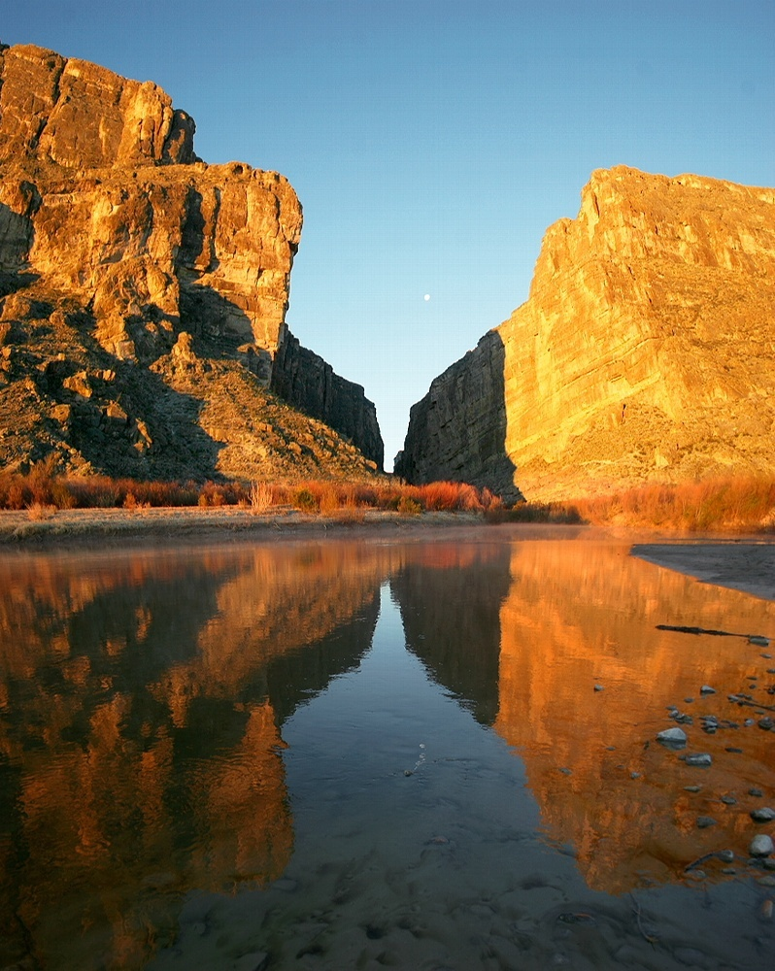
Santa Elena Canyon
Notes:
… and Santa Elena Canyon - a beautiful incision made by the Rio Grand River into limestone. The geologic story of these two park attractions will be discussed later as they are relatively recent features and we will be following a chronological sequence through the park’s geological evolution.

Slide 4
Big Bend Geologic History
Late Paleozoic: Ouachita folds and thrusts
Early Mesozoic: Peneplanation
Late Mesozoic: Foreland basin sedimentation
Early Cenozoic: Laramide folding and magmatism
Late Cenozoic: Erosion, deposition and Basin & Range extension
Notes:
That history breaks down nicely into five stages. The Ouachita Orogeny produces a fold and thrust belt in the Late Paleozoic. Those mountains become peneplaned and covered by foreland basin sediments in the Mesozoic. Folding volcanism and shallow intrusions occur during the Early Cenozoic Laramide Orogeny. Then the whole thing is extended in the Late Cenozoic in typical Basin and Range fashion while the Rio Grande River carves canyons across buried Laramide folds and Basin and Range fault blocks.

Slide 5
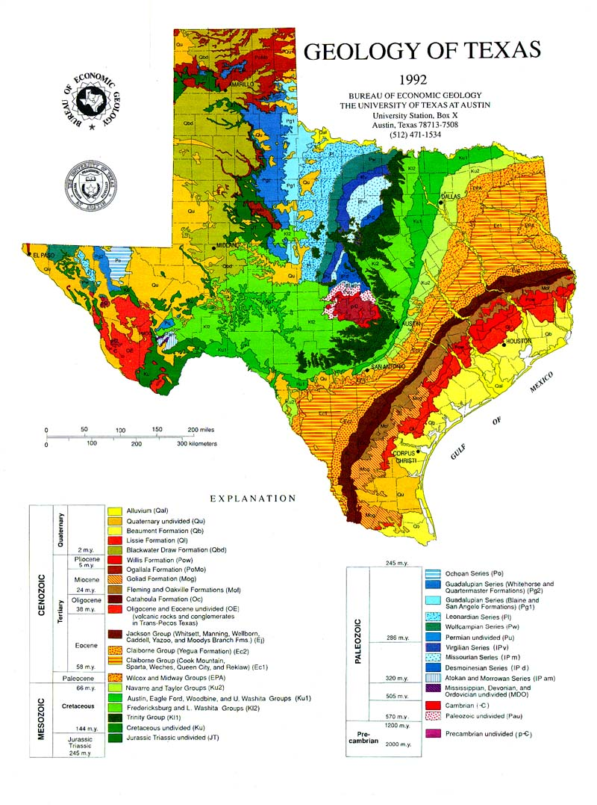
Big Bend
Notes:
The park gets its name from the abrupt change in direction of the Rio Grande River in mid-western Texas. As you can see from this geologic map most of the park is colored green on the map which is a pretty standard designation for rocks of the Cretaceous period.

Slide 6
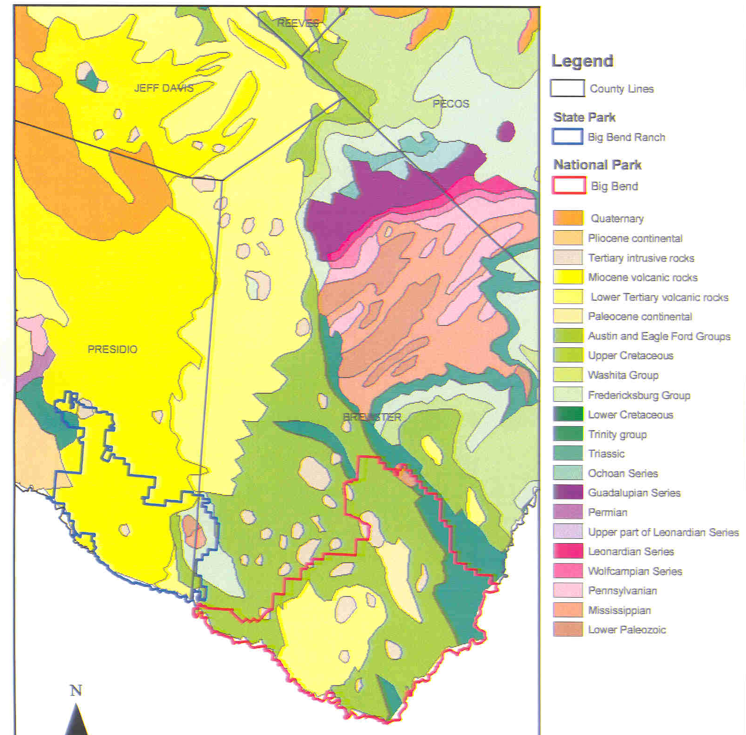
Paleozoic
Big Bend
Notes:
If we zoom in on the region we can see that the oldest rocks in Big Bend are Paleozoic in age.

Slide 7
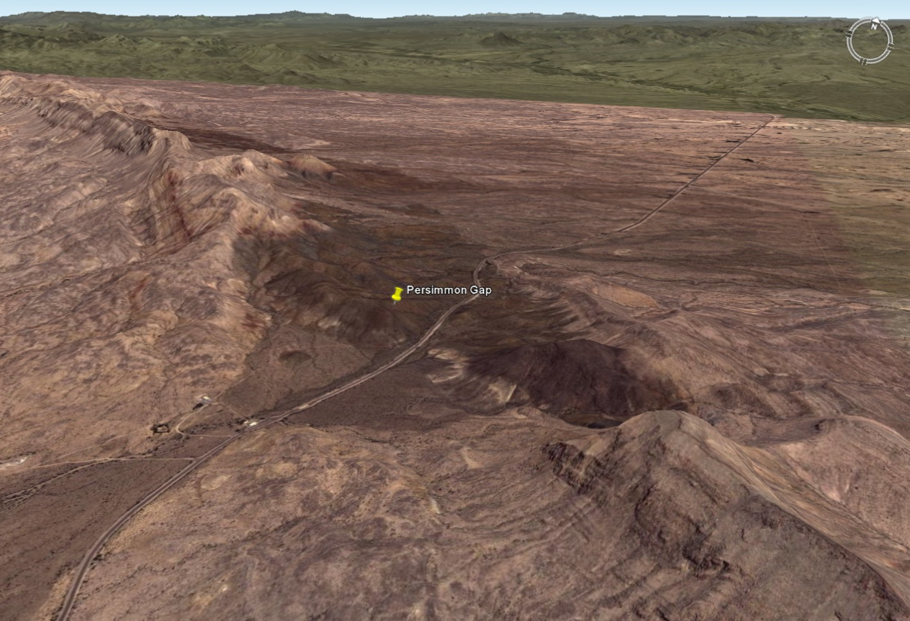
Notes:
These occur in a small wind gap which cuts through the Cretaceous strata which covers the Paleozoic sequence in other portions of the park.

Slide 8
Marathon Mountains
Notes:
If you want a good look at the Paleozoic rocks in the regions you have to look just slightly north of the park in the Marathon Mountains …

Slide 9
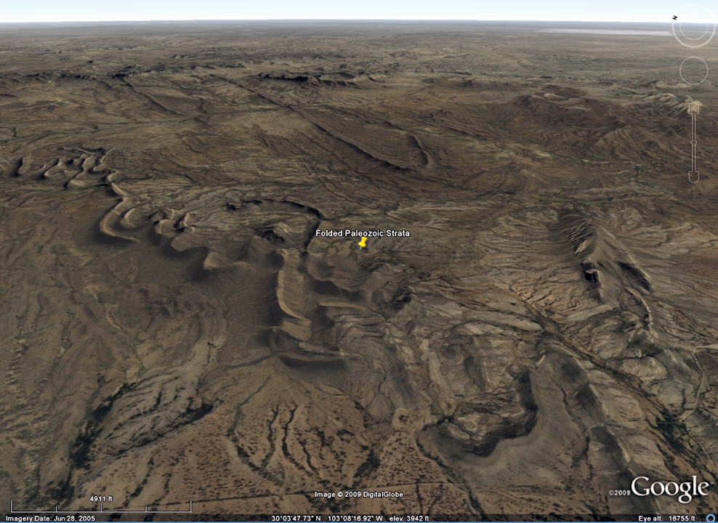
Folded Paleozoic strata in Marathon Mountains
Notes:
… where the Paleozoic strata is folded in a manner very similar to that of the Zigzag Range in the Arkansas Ouachitas.

Slide 10
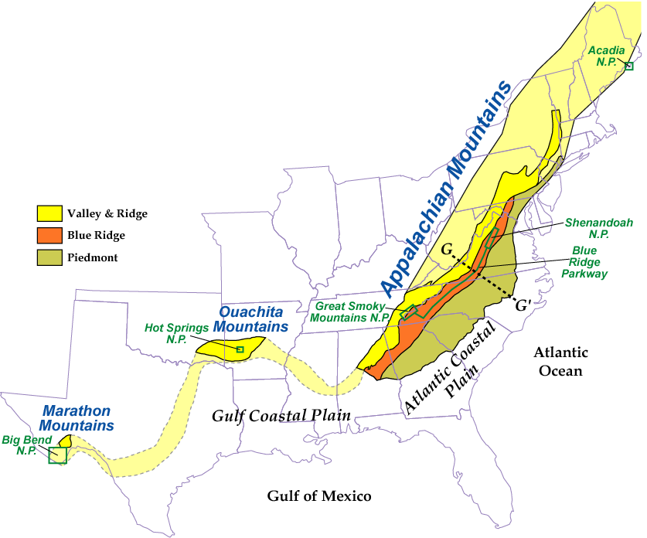
The Appalachian continental collision zones continues westward as the Marathon Mountains in West Texas
Parks and Plates
©2005 Robert J. Lillie
Notes:
Indeed the Marthon Mountains are considered to be an extension of the Ouachita/Appalachian system and were, like the Ouachitas, they formed by the collision of South America with North America in the Late Paleozoic. These same rocks and structures lie mostly buried in Big Bend …

Slide 11
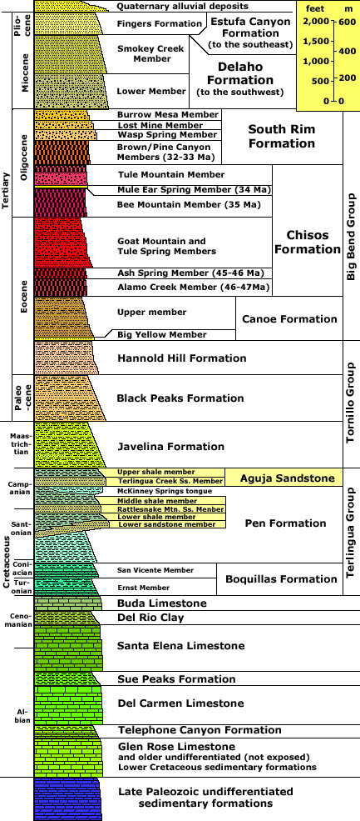
Cretaceous limestone (and shale)
Notes:
… beneath a thick sequence of mostly limestone of Cretaceous age.

Slide 12
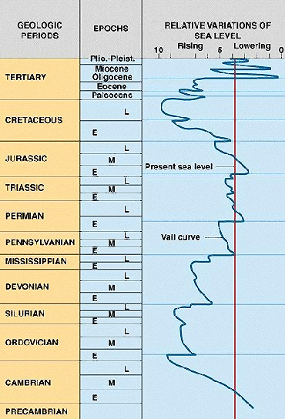
Notes:
That limestone deposited partly due to the highest global sea levels of all geologic time in the late Cretaceous, and partly due to local tectonic factors which will be discussed later.

Slide 13
Solitario Dome
Notes:
One of the best places to see the relationship between the Cretaceous limestone and the Paleozoic strata is Solitario Dome, which lies just outside Big Bend National Park but within Big Bend Ranch State Park.

Slide 14
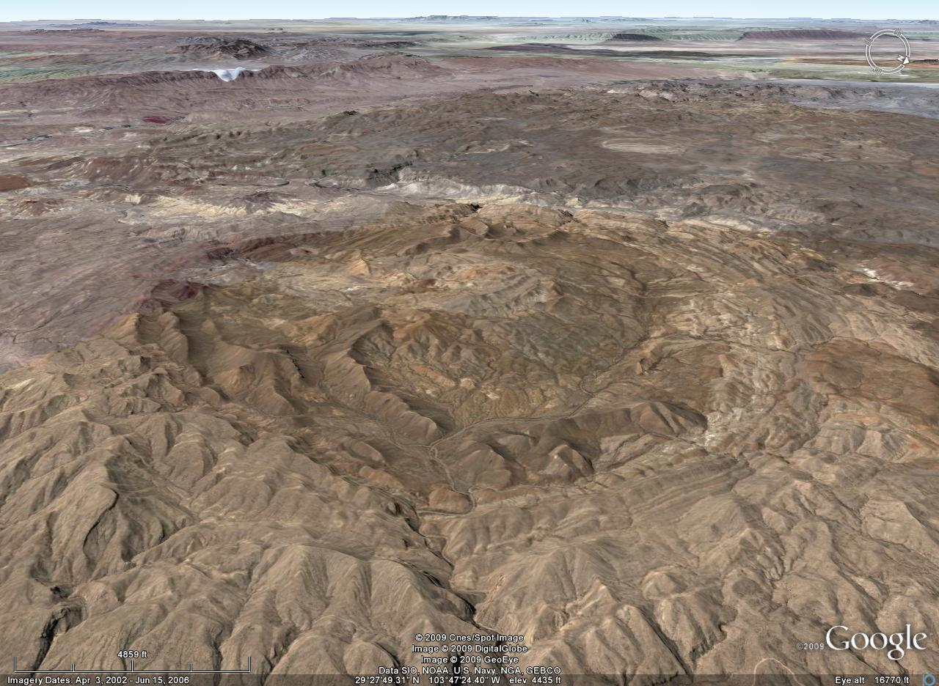
Solitario Dome
Notes:
Solitario Dome is a collapsed laccolith.

Slide 15
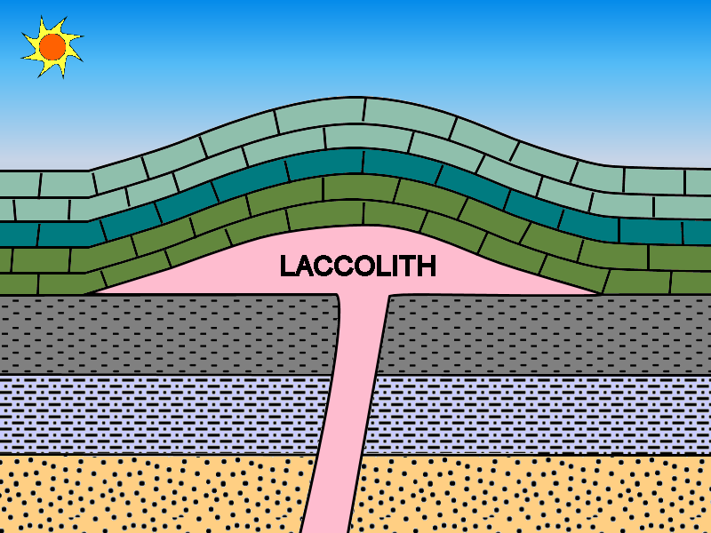
Solitario Dome
Notes:
Laccoliths are mushroom-shaped igneous intrusions that push the rocks above them upwards into a dome-shape. Normally the area would be a topographic high with the igneous rock of the laccolith exposed in the center, but here much of the magma escaped from the laccolith to the surface, so the whole thing deflated somewhat.

Slide 16
Paleozoic
Cretaceous
Cretaceous
Cretaceous
Notes:
In the core of Solitario Dome, erosion has exposed mostly Paleozoic sedimentary rocks surrounded by rings of Cretaceous strata that tilt away from the center.

Slide 17
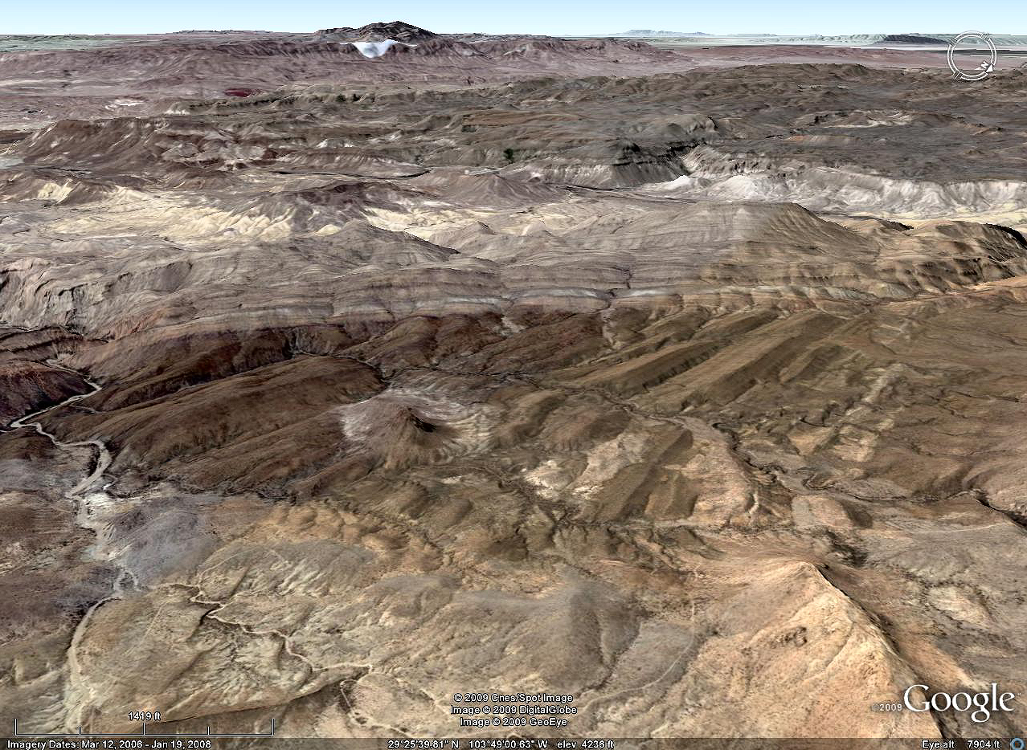
Notes:
If we zoom in on the contact between the two you can see a sight that surely would have inspired Hutton. No doubt you recognize the beautiful angular unconformity here.

Slide 18
Of course I do!
Notes:
…

Slide 19
Cretaceous
Paleozoic
Notes:
It separates the Paleozoic rocks below from the Cretaceous rocks above. The tilting you see in the Paleozoic strata was caused by the Ouachita Orogeny.

Slide 20
Big Bend Geologic History
Late Paleozoic: Ouachita folds and thrusts
Early Mesozoic: Peneplanation
Notes:
The unconformity indicates that the folded Paleozoic strata was peneplaned to a nearly level surface before the Cretaceous strata was deposited above it. Although both Cretaceous and Paleozoic strata here were tilted away from the center of the dome by the intrusion of the laccolith, the tilt of the Paleozoic strata is complicated by being superimposed on pre-existing Ouachita-style folds.

Slide 21
I do believe I feel a bit giddy!
Notes:
…

Slide 22
Yee-hah!
Notes:
…

Slide 23
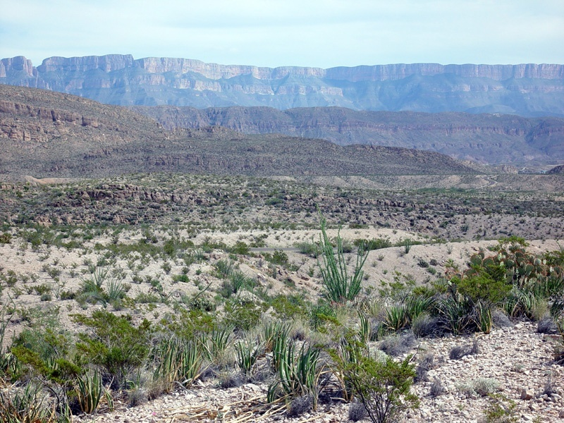
Sierra del Carmen
Notes:
The Cretaceous strata is mostly limestone with lesser amounts of interbedded shale. The limestone is highly erosion resistant in this arid climate and is a prolific cliff-former.

Slide 24
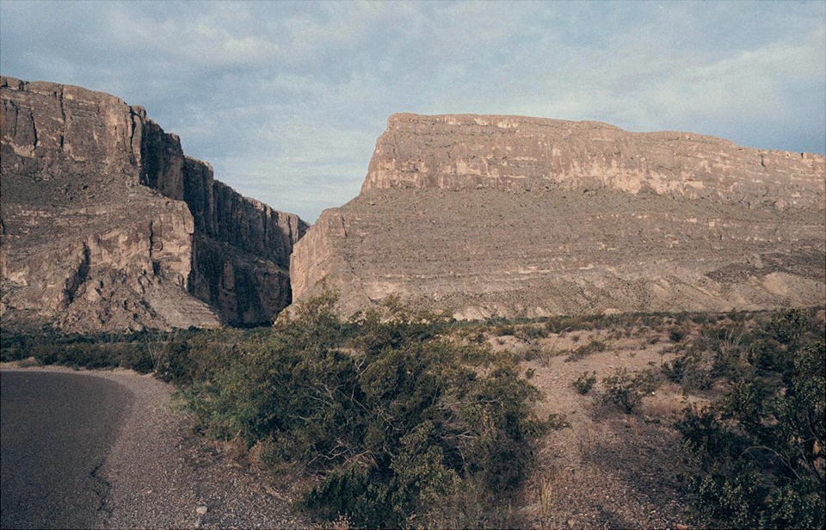
Notes:
Limestone is water-soluble however, so where the Rio Grande flows across it becomes far more eroded – forming the spectacular slot canyons for which the park is noted. It is difficult to contemplate the staggering number of shelled organisms that had to have lived (and died!) in order for such thick deposits of lime to accumulate.

Slide 25
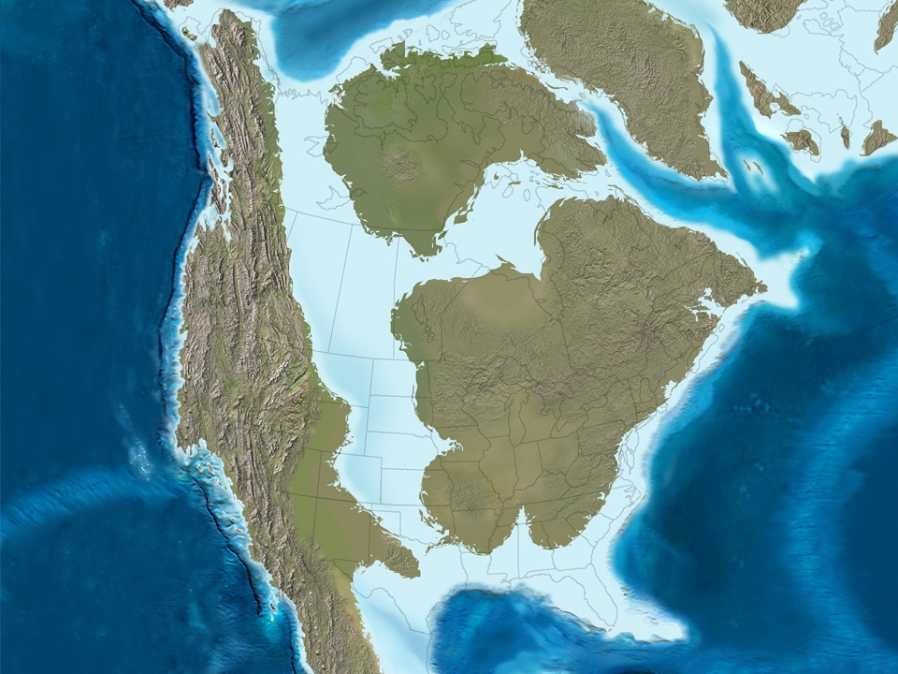
Late Cretaceous
Notes:
Those organisms lived in a vast shallow sea that once connected the Gulf of Mexico with the Arctic Ocean.

Slide 26
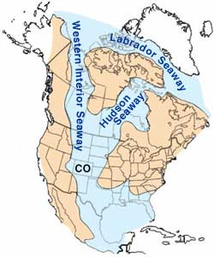
Notes:
That sea is usually referred to as the Western Interior Seaway or alternately the Cretaceous Interior Seaway. The spectacularly high sea levels of the Late Cretaceous certainly contributed to the formation of this epicontinental sea, but there is a definite tectonic contribution as well which is related to the formation of the Cordilleran Mountain systems in western North America.

Slide 27
Notes:
To understand how Cordilleran orogeny produced the Western Interior Seaway, visualize the North American continent as a plank of wood floating on water. Now compress the board lengthwise …

Slide 28
Cordilleran
Foreland basin
Notes:
… such that it fractures and one part of the board is thrust over the other. The over thrust represents the Cordilleran while the under thrusted portion represents the North American craton. Notice under thrusting places part of the craton below sea level and thereby creates a foreland basin which in this case is the Western Interior Seaway.

Slide 29
Hinterland
Foreland basin
Notes:
The Cordilleran is the hinterland here …

Slide 30
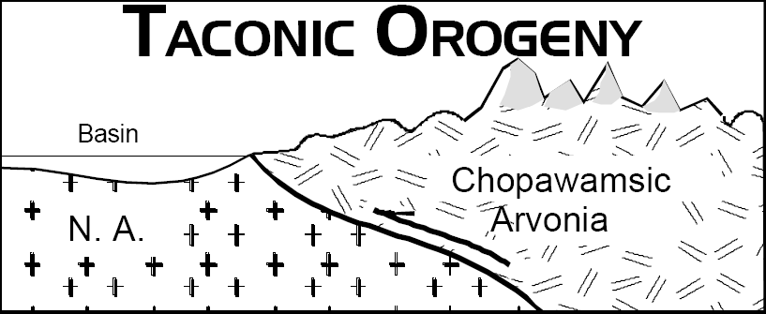
Foreland basin
Hinterland
Notes:
… similar to the hinterlands associated with foreland basins formed during the various Appalachian orogenies.

Slide 31
Notes:
An even simpler explanation for the formation of such foreland basins merely relies on the topographic load of the mountain range to depress the craton.

Slide 32
Cordilleran
Notes:
In this model the weight of the Cordilleran mountains …

Slide 33
Foreland basin
Notes:
… sinks the craton below sea level to form a foreland basin.

Slide 34
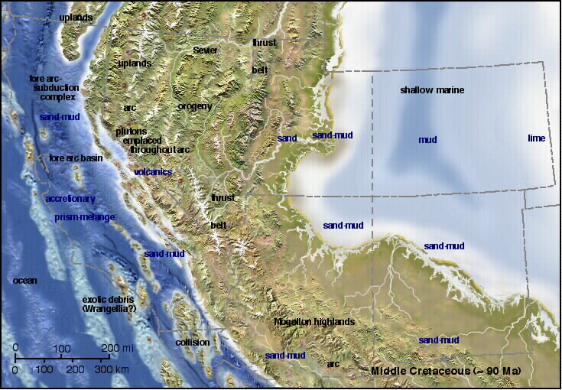
Western Interior Seaway
Notes:
The models could operate separately or in conjunction with each other, but in either case the Western Interior Seaway is a profoundly influential component of the Late Cretaceous paleogeography of North America.

Slide 35
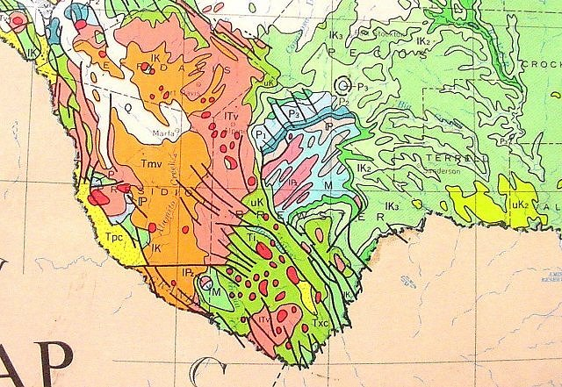
Cretaceous strata
Notes:
It explains why there is so much Cretaceous limestone in and around Big Bend National Park.

Slide 36
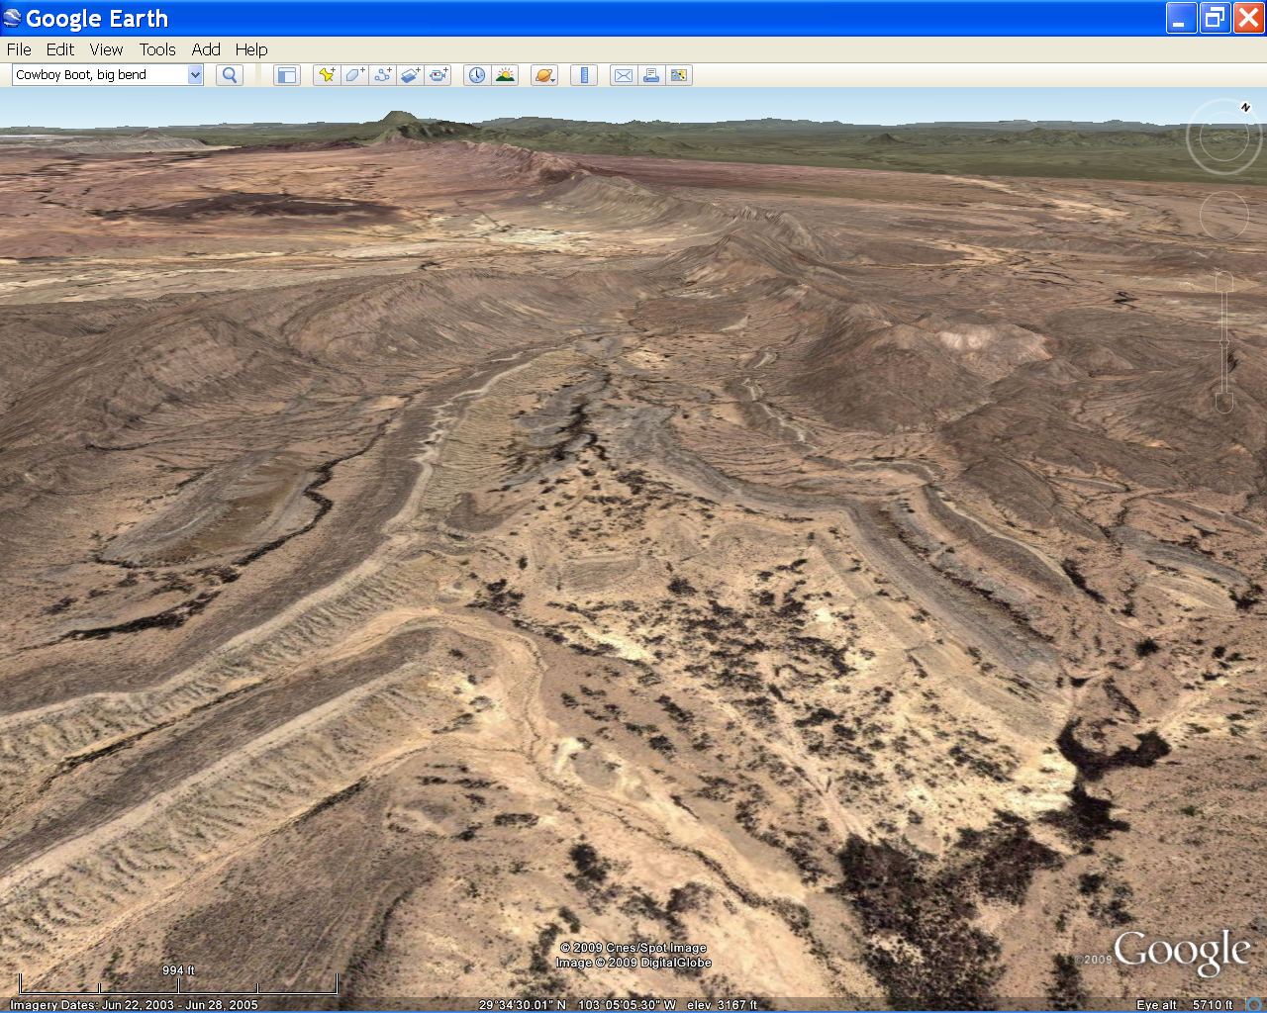
Big Bend Geologic History
Late Paleozoic: Ouachita folds and thrusts
Early Mesozoic: Peneplanation
Late Mesozoic: Foreland basin sedimentation
Early Cenozoic: Laramide folding and magmatism
Late Cenozoic: Erosion, deposition and Basin & Range extension
Notes:
Although the Cretaceous limestone was deposited originally horizontal, it was compressed during the Laramide Orogeny …

Slide 37
Sierra Del Carmen - a Laramide anticline
Notes:
… into broad folds which are common in Big Bend country.

Slide 38
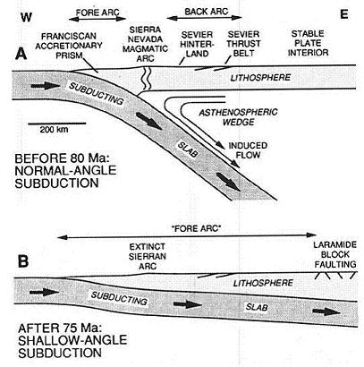
Notes:
The classic explanation for the Laramide Orogeny involves the shallowing of the subduction angle of the Farallon Plate caused by an unusually rapid rate of convergence with the North American Plate. Note that the affects of Laramide compression are felt far to the east of the Sierras. In this case, all the way into Texas.

Slide 39
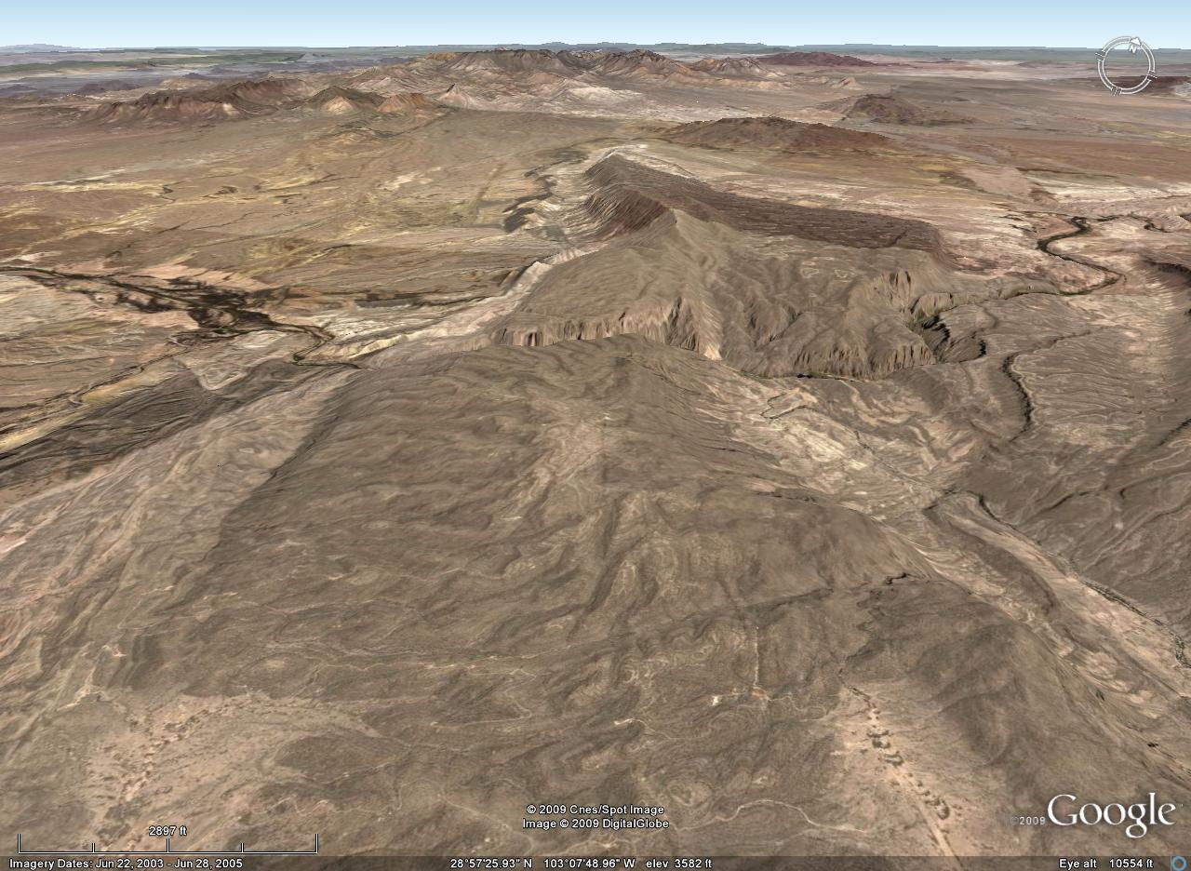
Rio Grande River
Mariscal Anticline
Notes:
The Laramide-age folds had a profound influence on the development of several of Big Bend’s landforms especially the deep, slot canyons formed where the Rio Grande River crosses Laramide anticlines. Mariscal Anticline here is one of these.

Slide 40
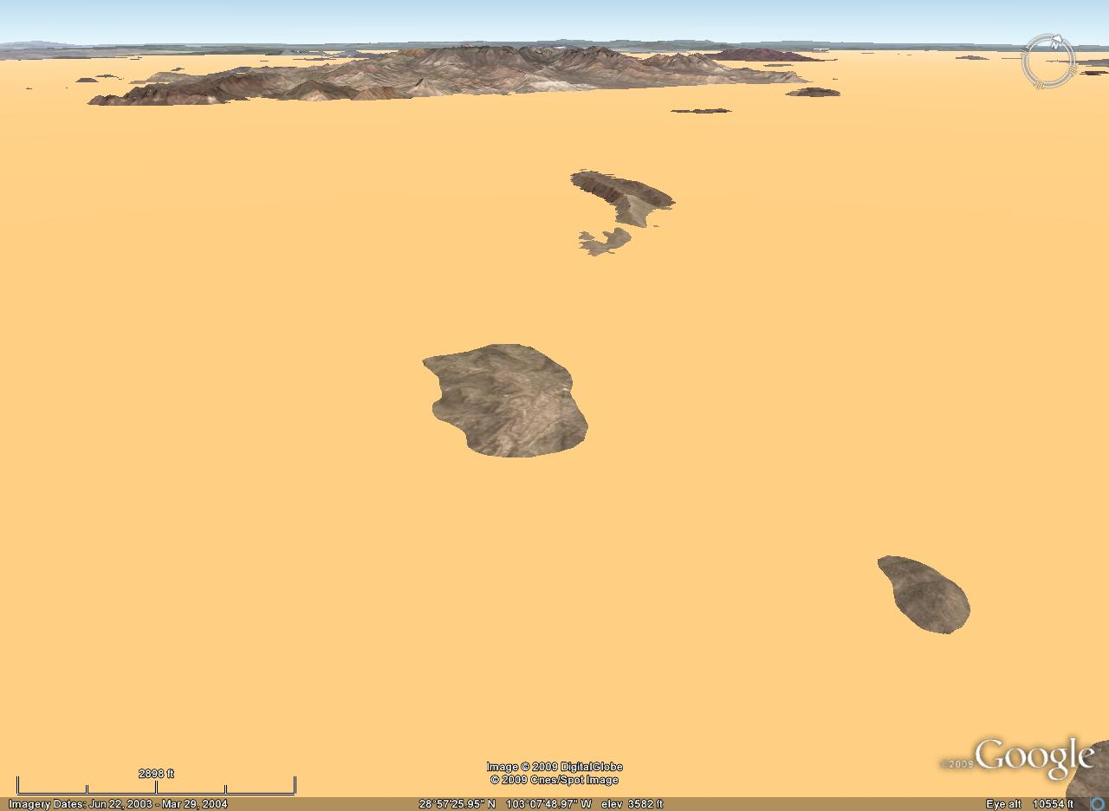
Notes:
After the anticline formed, …

Slide 41
Big Bend Geologic History
Late Paleozoic: Ouachita folds and thrusts
Early Mesozoic: Peneplanation
Late Mesozoic: Foreland basin sedimentation
Early Cenozoic: Laramide folding and magmatism
Late Cenozoic: Erosion, deposition and Basin & Range extension
Notes:
… like most of the Laramide-age structures, it was eroded and buried under thick alluvium.

Slide 42
Notes:
This allowed the Rio Grande River to flow across the buried anticline.

Slide 43
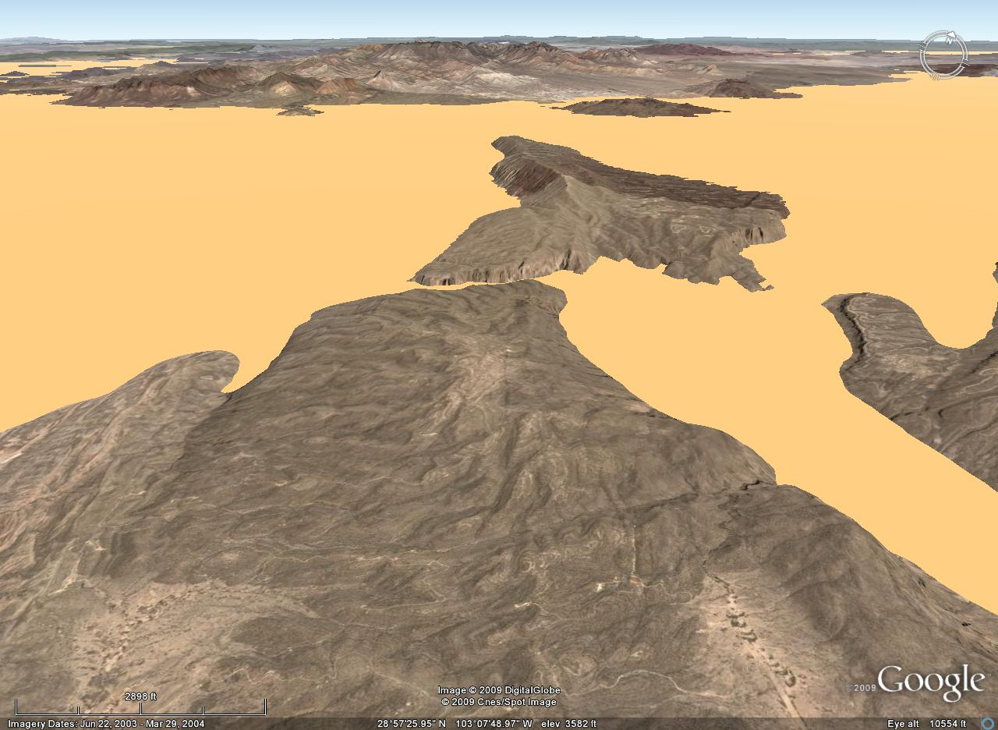
Notes:
As the river eroded downward the softer alluvial sediments where preferentially removed, …

Slide 44
Notes:
…thereby exposing the harder rocks in the buried anticline while the river cuts a water gap across it.

Slide 45
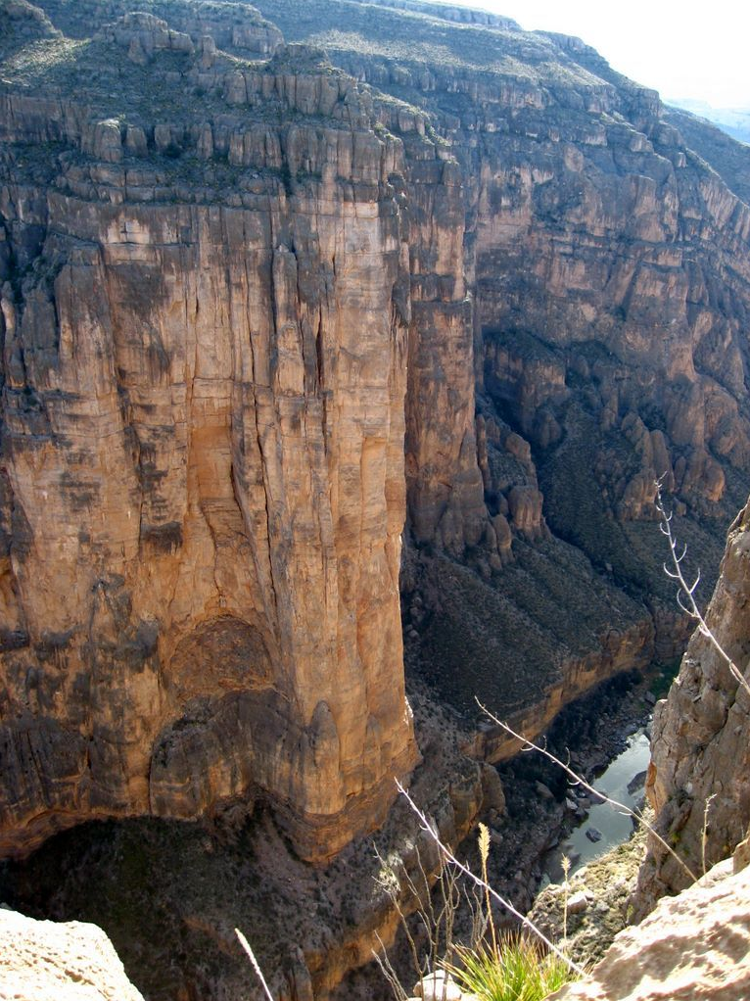
Mariscal Canyon
Notes:
Mariscal Canyon is an impressive slot canyon water gap formed in this way …

Slide 46
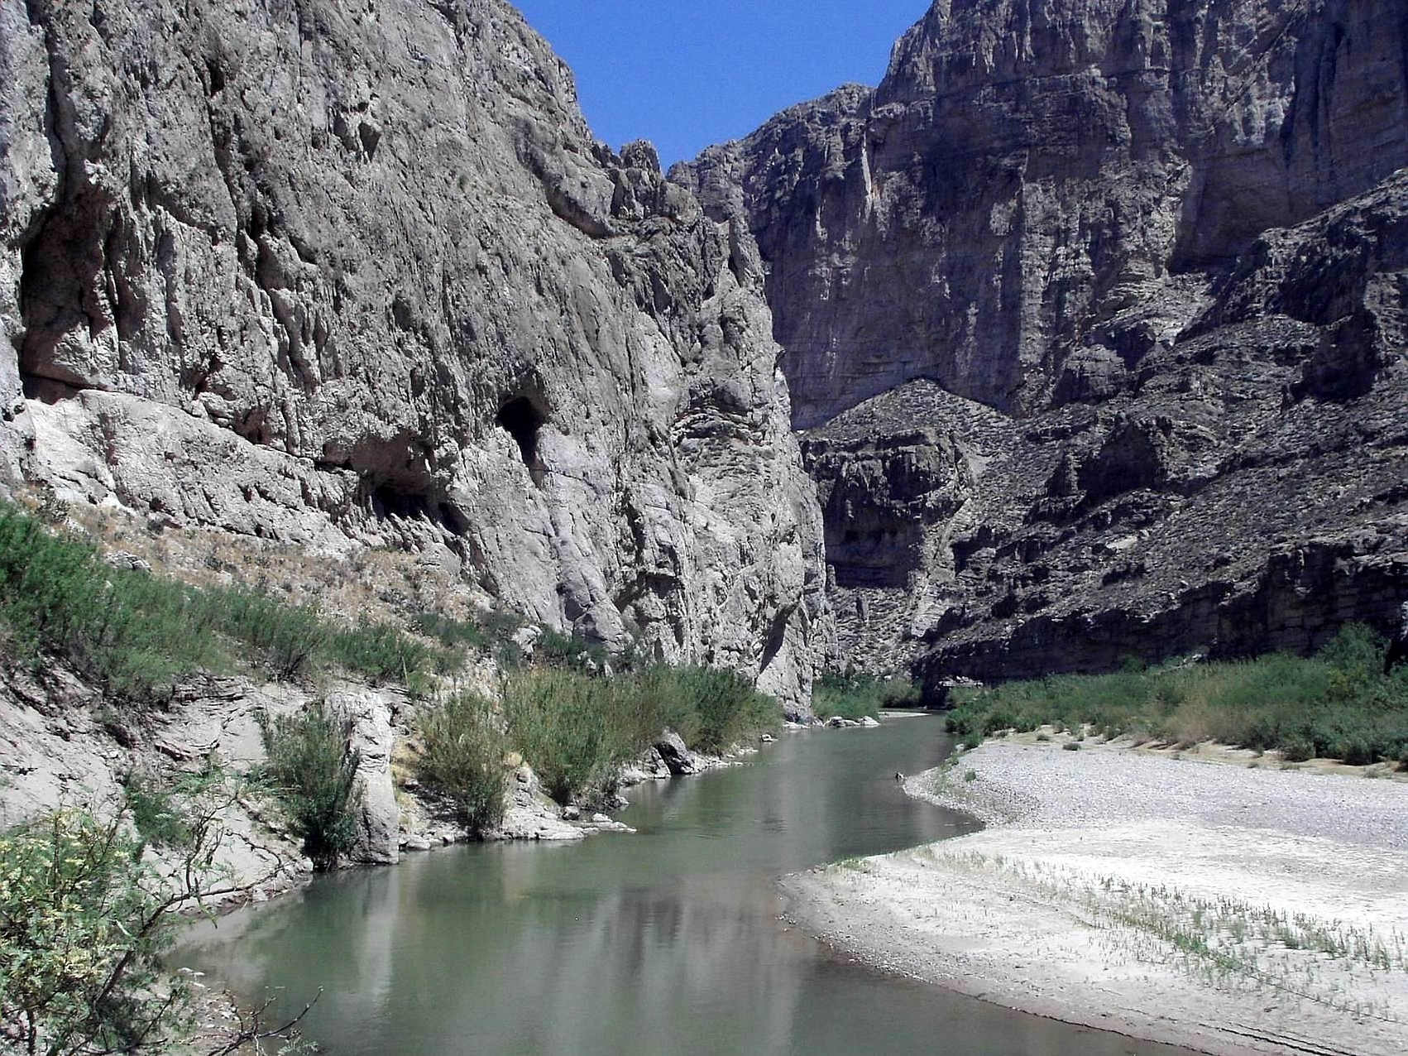
Boquillas Canyon
Notes:
… as is Boquillas Canyon a few miles downstream. The rocks exposed here are part of another Laramide anticline which uplifted the Cretaceous limestone.

